Slide 1
chapter 7
Voice Networks

Slide 2
CHAPTER OBJECTIVES
7-<number>
Identify the business purpose of voice networks.
Describe how data is transmitted over a plain old telephone system local loop.
Identify the business purpose and features of a private branch exchange.
Define PBX technology and discuss PBX switching topologies and design considerations.
Identify the business purpose of an IP-PBX.
Describe the converged and packet-switched topologies of an IP-PBX.

Slide 3
CHAPTER OBJECTIVES (cont’d)
7-<number>
Define and describe voice over IP (VoIP).
Discuss cellular wireless voice networks and describe the anatomy of a cellular wireless connection.
List and describe three cellular wireless access methods.
Identify and describe three cellular wireless topologies and connectivity to the PSTN.
List and discuss cellular wireless data services.

Slide 4
VOICE NETWORKS – AN INTRODUCTION
7-<number>
Voice networks convey the human voice between remote locations.
Voice networks use electrical transmission techniques.
Voice networks were in existence long before modern data networks.
Voice networks have traditionally used analog transmission techniques where data networks generally use digital methods.
Voice networks have traditionally been constructed and maintained separately from data networks.

Slide 5
VOICE NETWORKS – AN INTRODUCTION (cont’d)
7-<number>
From the late 1870s – 1950s, voice networks were specifically used for the analog transmission of the human voice.
In the 1960s and 1970s, organizations with mainframe computers began using telephone companies’ analog voice networks to share computing resources and to transmit digital data between remote locations.
Modern voice networks can be based on analog or digital techniques or a combination of both.

Slide 6
VOICE NETWORKS – AN INTRODUCTION (cont’d)
7-<number>
Earliest voice networks appeared after the introduction of the first commercial telephone in the late 1870s.
These early telephone networks connected a person’s home directly with another person’s home to create a point-to-point connection.
Subsequent connections to others’ homes required the installation of additional point-to-point connections.

Slide 7
VOICE NETWORKS – AN INTRODUCTION (cont’d)
7-<number>
All these point-to-point connections were inefficient to install and maintain.
This led to the development in 1878 of the first telephone exchange, which is also known as a telephone central office (CO).
A CO is a physical facility owned by the telephone company, and it acts as a hub to which all telephone subscribers in a specific geographic region connect.
When a subscriber makes a call, the call connects to the CO, and then the call is connected to another subscriber.

Slide 8
VOICE NETWORKS – AN INTRODUCTION (cont’d)
7-<number>
Modern connections between a home or office and a CO is provided by a local exchange carrier (LEC).
The connection between home or office and the CO is known as a local loop.
Local loops consist of a pair of twisted copper wires that are like the UTP cabling used in data networks.
Local loops in combination with one or more COs form the basic voice network for local calls.

Slide 9
VOICE NETWORKS – AN INTRODUCTION (cont’d)
7-<number>
Local loops and COs in combination with long-distance technologies comprise a voice network that is commonly referred to as the plain old telephone system (POTS).
Formally, POTS is better described as the public switched telephone network (PSTN).
POTS provides the basic foundation for the voice network that spans across the Korea and the entire world.
POTS is technically that part of the PSTN that services regular analog telephones.

Slide 10
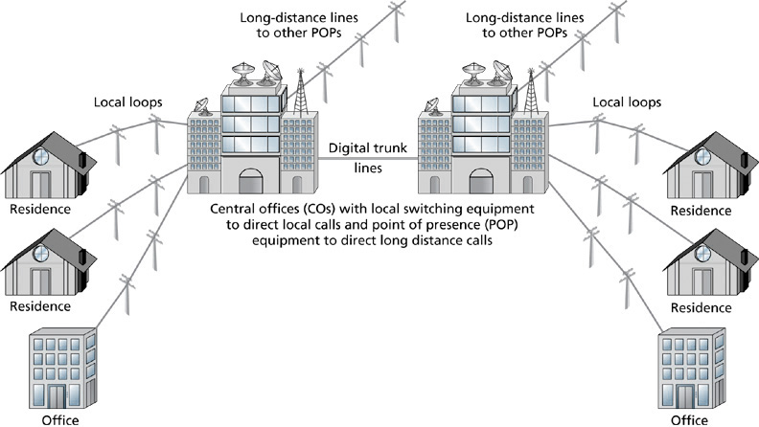
Plain Old Telephone System (POTS)
7-<number>

Slide 11
VOICE NETWORKS – AN INTRODUCTION (cont’d)
7-<number>
If a call is long-distance, point of presence (POP) equipment owned by an inter-exchange carrier (IXC or IEC) transmits the call along the appropriate long-distance communications path.
Long-distance calls are received at a remote POP, switched to the destination LEC, and then connected to the remote subscriber.

Slide 12
VOICE NETWORKS – AN INTRODUCTION (cont’d)
7-<number>
Business Purpose of Voice Networks
  Transmission of human voice as well as data between point A and point B.
  Organizations use POTS and the PSTN for simple analog voice and data communications over POTS to switched digital services such as ISDN.
  The PSTN services voice and data transmission across trunks to organizations’ private branch exchange (PBX) systems.
  Cellular wireless also relies on the PSTN for connecting voice and data transmissions between points A and B.

Slide 13
VOICE NETWORKS – AN INTRODUCTION (cont’d)
7-<number>
Digital data transmissions across POTS use modems.
A modem modulates a simple carrier wave into different frequencies, amplitudes, and phases, and then demodulates the signal at the receiving end.
Modem development spawned the beginning of data communications over regular telephone lines.

Slide 14
PRIVATE BRANCH EXCHANGE
7-<number>
A private branch exchange (PBX) is a private version of the PSTN central exchange.
A PBX can be implemented by an organization to control and manage voice network use, functionality, and costs.
With PBX implementation, control, management, and cost of a substantial part of an organization’s voice network passes from the telephone company to the organization itself.

Slide 15
PRIVATE BRANCH EXCHANGE (cont’d)
7-<number>
PBX Business Purpose and Features
  PBXs have existed for over 100 years.
  First PBXs were switchboards installed at business locations in the late 1800s and early 1900s.
  Business subscribers and the telephone company both benefited with the installation of a PBX.
  Businesses could reduce the rental costs of having multiple local loops.
  Telephone company could reduce the expense of installing and supporting additional local loops for businesses.

Slide 16
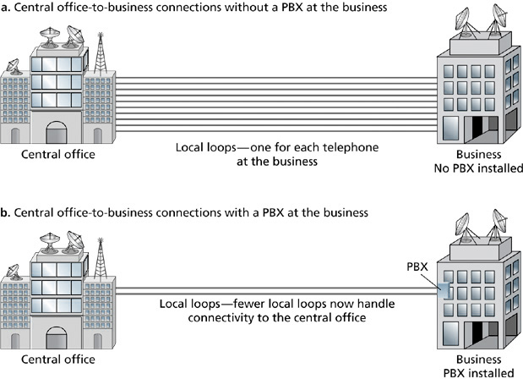
Connectivity to Central Office Exchange
7-<number>

Slide 17
PRIVATE BRANCH EXCHANGE (cont’d)
7-<number>
Early PBX Systems
  Were manually operated switchboards.
  They were installed, owned, and maintained by the telephone company for a fee.
  Business subscriber enjoyed the benefits of internal call switching and control.
  Business subscriber also enjoyed a cost structure that was offset by reduced local loop charges.

Slide 18
PRIVATE BRANCH EXCHANGE (cont’d)
7-<number>
Modern PBX Systems
  Include the features of early PBXs such as efficiencies of internal call switching and control as well as cost savings.
  Include services that are designed to improve voice network performance and communications efficiency.

Slide 19
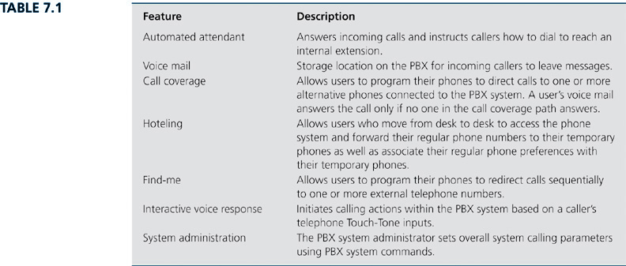
Common Features of Modern PBXs
7-<number>

Slide 20
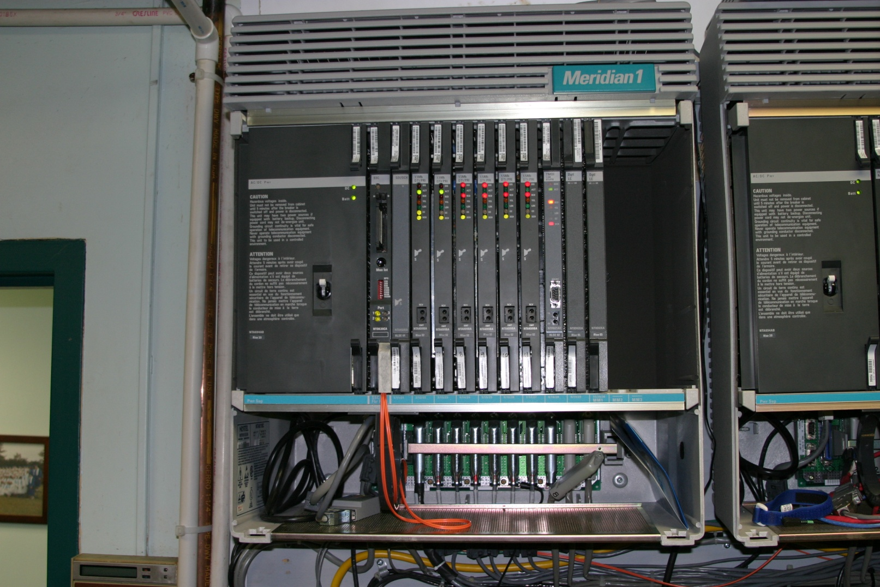
PBX Components
7-<number>

Slide 21
PRIVATE BRANCH EXCHANGE (cont’d)
7-<number>
PBXs and Wireless Communications
  Regular cell phones can be partially integrated with PBX systems.
  Users’ cell phone numbers can be programmed into the PBX database to take advantage of PBX features.
  Regular cell phones do not receive their dial tone, call processing, or switching functions from the PBX – the cellular service company provides those functions.
  Wireless PBX phones usually sell at a significant premium over regular cell phones.

Slide 22
IP-PRIVATE BRANCH EXCHANGE
7-<number>
The two major IP-PBX topologies are
  Converged IP-PBX systems, which combine the best of traditional PBX systems with Ethernet IP networks.
  IP packet-switched systems, which uses the existing infrastructure and protocols of an IP Ethernet network to process, switch, and transport voice traffic.
  Both types integrate voice traffic onto highly efficient and cost-effective data networks.

Slide 23
IP-PRIVATE BRANCH EXCHANGE (cont’d)
7-<number>
Voice over IP is the combination of hardware, software, and protocols that support voice communications over IP networks.
Client/server IP-PBX topologies are an example of VoIP.
VoIP protocols fall into two levels of functionality: call signaling and call transport.

Slide 24
CELLULAR WIRELESS VOICE NETWORKS
7-<number>
Anatomy of a Cellular Wireless Connection
  When a cellular wireless device is powered on, it transmits its identity signal to the nearest cell tower.
    The transmission takes place using a radio frequency.
  The cell tower responds, providing cell network information.
    This transmission takes place using a different radio frequency that establishes a control channel between the cell phone and the cellular network.

Slide 25
CELLULAR WIRELESS VOICE NETWORKS (cont’d)
7-<number>
Anatomy of a Cellular Wireless Connection (cont’d)
  When a caller dials a number and presses Send, the number is transmitted across the control channel to the cell tower.
  The cell tower relays the call to a mobile switching center (MSC).
  The MSC instructs the cellular device that’s making the call to use a specific set of frequencies known as the traffic channel for voice and data communication between the cell device and the cell tower.

Slide 26
CELLULAR WIRELESS VOICE NETWORKS (cont’d)
7-<number>
Anatomy of a Cellular Wireless Connection (cont’d)
  The MSC also scans its database to see whether the number being called is within the MSC’s cellular network or part of another wireless system.
  Mobile-to-mobile calls that are within the same cell or group of cells that is connected to the same MSC are switched at the MSC to their destination.
  Mobile-to-land calls or mobile calls to other cell networks must be routed through the MSC to the PSTN.

Slide 27
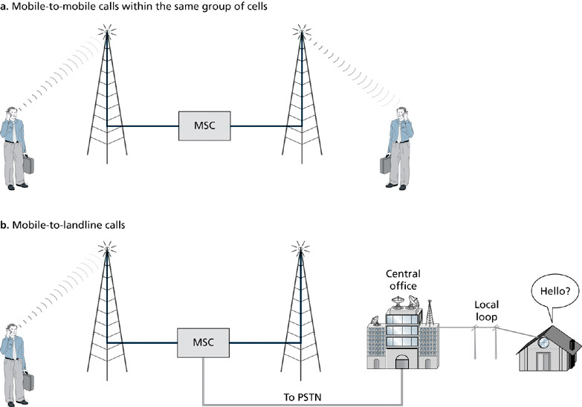
Anatomy of a Cellular Wireless Call
7-<number>

Slide 28
CELLULAR WIRELESS VOICE NETWORKS (cont’d)
7-<number>
Cellular Wireless Access Methods
  Wireless access methods are also known as air interfaces.
  The most common air interfaces today are Time Division Multiple Access (TDMA) and Code Division Multiple Access (CDMA)
  Frequency Division Multiple Access (FDMA) was prevalent in the 1980s.

Slide 29
CELLULAR WIRELESS VOICE NETWORKS (cont’d)
7-<number>
FDMA
  Is an analog cellular wireless access method.
  It was implemented in test markets in the late 1970s in the U.S.
  It became the air interface for the first widely deployed cellular wireless network in the early 1980s.
  This early analog cellular network became known as Advanced Mobile Phone Service (AMPS)

Slide 30
CELLULAR WIRELESS VOICE NETWORKS (cont’d)
7-<number>
TDMA
  TDMA adds a time dimension to FDMA to make more efficient use of the radio frequency bandwidth.
  With TDMA, multiple calls are multiplexed across the same frequency.
  TDMA requires less power consumption than FDMA.
  TDMA is offered as an air interface by some cellular carriers, but it is generally deployed as the underlying air interface for the Global System for Mobile Communications (GSM)

Slide 31
CELLULAR WIRELESS VOICE NETWORKS (cont’d)
7-<number>
CDMA
  It’s an air interface that was developed for the US military in the 1960s.
  CDMA eliminates some of the inefficiencies associated with FDMA and TDMA by spreading a call or data transmission across multiple frequencies.

Slide 32
CELLULAR WIRELESS VOICE NETWORKS (cont’d)
7-<number>
CDMA (cont’d)
  Bandwidth efficiency is also improved by spreading a transmission across multiple frequencies – the number of callers that can simultaneously use a range of radio frequencies for call transmission is increased with CDMA.
  CDMA offers a better method of call handoff and call signal reflection management so that CDMA phones consume less power than their TDMA or FDMA counterparts.

Slide 33
CELLULAR WIRELESS VOICE NETWORKS (cont’d)
7-<number>
Wireless Data Services
  Provide a wireless carrier connection between individual remote users and parent organization networks.
  Data rates range from about 100 Kbps to 2.4 Mbps.
  Wireless data services are classified in terms of 2G, 2.5G, 3G, and 4G wireless data communications technologies.

Slide 34
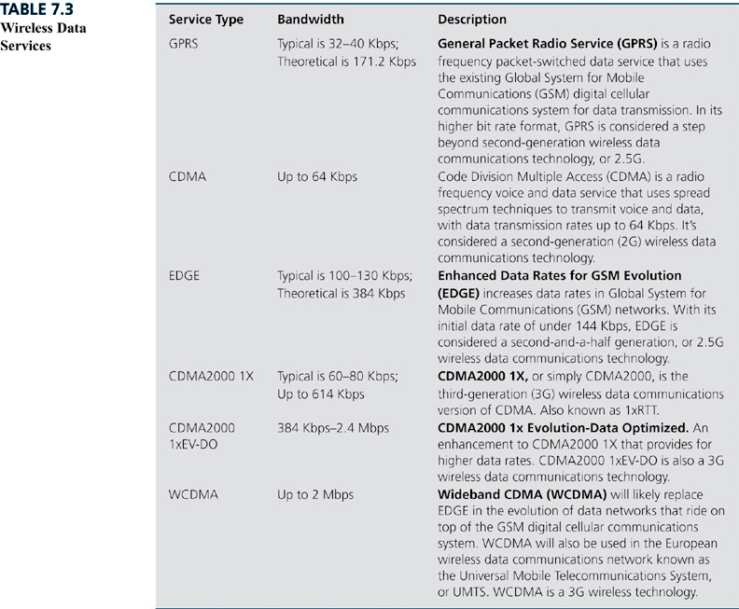
Wireless Data Services
7-<number>

